Slide 1

Writing Core Subtests on the KTEA 3
Denise DeLoria, Elementary SPED Instructional Coach
Denise_deloria@chino.k12.ca.us
Teresa Lackey, Secondary SPED Instructional Coach
Teresa_lackey@chino.k12.ca.us
Notes:
In this section of Special Education Assessments we are going to be looking at the Writing Core Subtests

Slide 2
Learn
Learning Outcomes
For the subtests:
Written Expression
Spelling
How to identify Basal and Ceiling
How to Score the subtests
Notes:
We are going to look at the Written Expression subtest along with the Spelling subtest. We will look at how to identify the basal and the ceiling and how to score the subtests.

Slide 3
Core Composites & Subtests
Reading:
Letter & Word Recognition
Reading Comprehension
Academic Skills Battery
Math:
Math Concepts & Application
Math Computations
Written Language:
Written Expression
Spelling
Notes:
These are the 6 subtests that make up the core composites. Under written language you will find written expression and spelling.

Slide 4



WRITTEN EXPRESSIOIN

Slide 5


KTEA-3 Response Booklet
This will be used with only the tests listed on the front.
Students write in this booklet
Notes:
For the writing core you may use the written expression level 1, if you are testing a student in the PK or K level, it starts on page 28 and spelling starts on page 31.

Slide 6
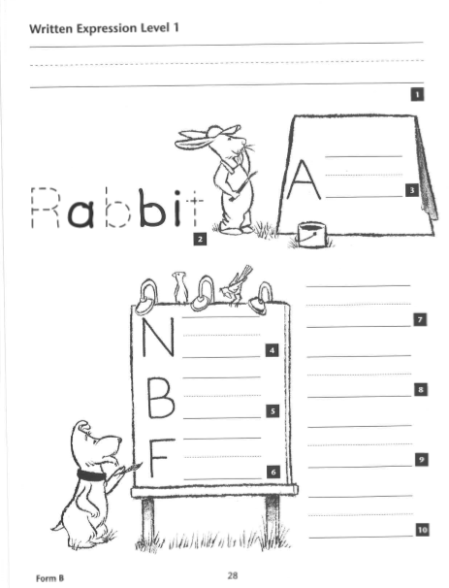
KTEA-3 Written Expression
Form A or B
Level 1, PK-K
In Response Booklet
Notes:
This is Level 1 used for PK and K

Slide 7
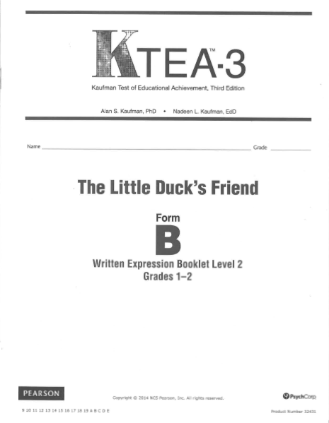
KTEA-3 Written Expression Booklet
Form A or B
Each form (A or B) has its own story title and topic
Level 2, Grades 1-2
Notes:
This is level 2 for the written expression which is used for grades 1 or 2. Students would write in this booklet.

Slide 8

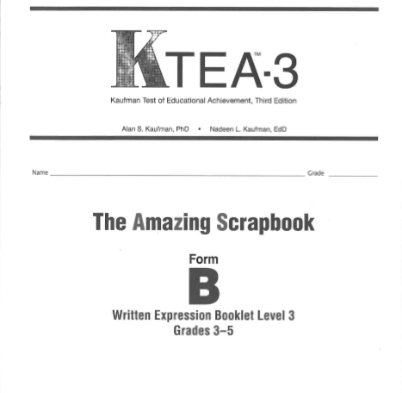
KTEA-3 Written Expression Booklet
Form A or B
Each form (A or B) has its own story title and topic
Level 3, Grades 3-5
Notes:
This is level 3 for the written expression, this is used for students in grades 3 -5. Students would write in this booklet.

Slide 9
KTEA-3 Written Expression Booklet
Form A or B
Each form (A or B) has its own story title and topic
Level 4, Grades 6-12
Notes:
This is level 4 for the written expression, used for students in grades 6-12. Students would write in this booklet.

Slide 10

SCORING WRITTEN EXPRESSION
Notes:
Now we can look at the Basal or where to start, the Discontinue or where to stop and if/when you will need to fall back to a new starting point.

Slide 11
KTEA-3 Record Form
Used for scoring
Can be Form B or Form A (blue)
Notes:
This is the record form. It will be used to score all of your subtests given.

Slide 12
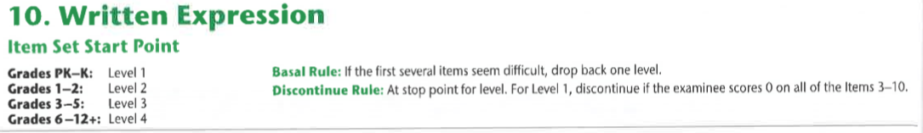
Begin the subtest at the student’s grade level
Basal Rule gives the examiner choice on weather to drop back a
level or not.
Discontinue at the stop point
Notes:
Each examinee must take one entire level. The level recommended for each grade is shown in the record form. If you expect an examinee to perform well below or above average for his/her grade, you may administer a lower or higher level than the one recommended.

Slide 13
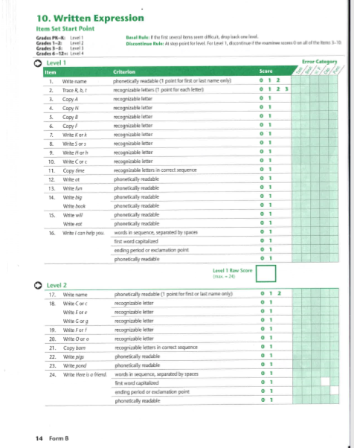
SCORING
Each item is scored on several criteria. Each criterion is scored 1 or 0.
Score each criterion independently of the others.
To calculate the rew score, sum the scores for all items included in the level taken by the examinee.
Refer to the Scoring Manual (Pg. 25) for item by item scoring instructions.
Notes:
On an item that asks the examinee to write a phrase or sentence, if a response is incomprehensible or the examinee does not response, score 0 for all criteria for the item. With exception for punctuation or capitalization where credit may be given if it is obvious that the examinee has done this correctly.

Slide 14

SPELLING

Slide 15
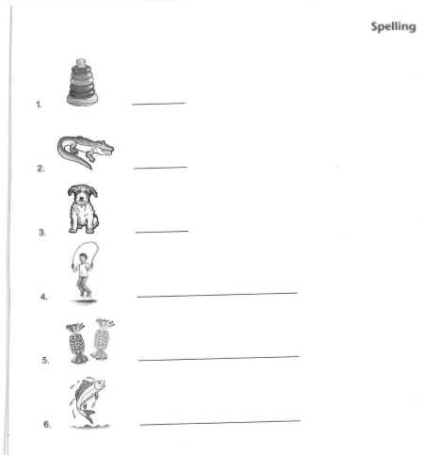
Spelling
Open the Response Booklet to the Spelling page with the appropriate start point and place it in front of the examinee.
You may repeat the word or sentence if the examinee asks you to, or if you think he or she did not hear it.
Notes:
ALWAYS MAKE SURE THE EXAMINEE WRITES EACH WORD NEXT TO ITS CORRESPONDING NUMBER.

Slide 16
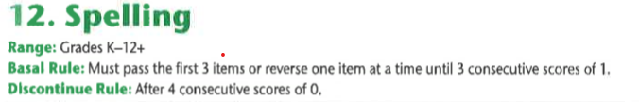
Basal: The examinee must pass the FIRST 3 items given or reverse one item at a time until 3 consecutive scores of 1.
Discontinue: Stop testing after 4 consecutive scores of 0.
Notes:
You will score based on spelling only. Do not penalize for poorly formed letters, use of upper and/or lower-case letters or the use of print and/or cursive.

Slide 17

denise_deloria@chino.k12.ca.us
Elementary Special Education Instructional Coach
teresa_lackey@chino.k12.ca.us
Secondary Special Education Instructional Coach
Notes:
Thank you for your time and please feel free to contact either one of us if you have any questions or concerns.

